Slide 1
British Airways
Predictive model and its results
09.02.2026

Slide 2
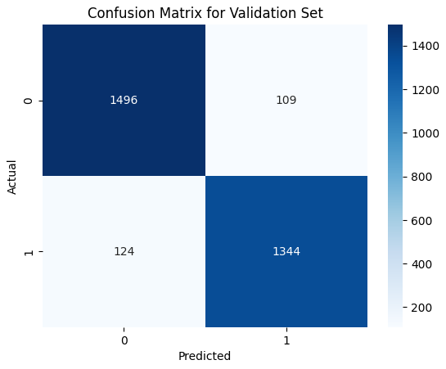
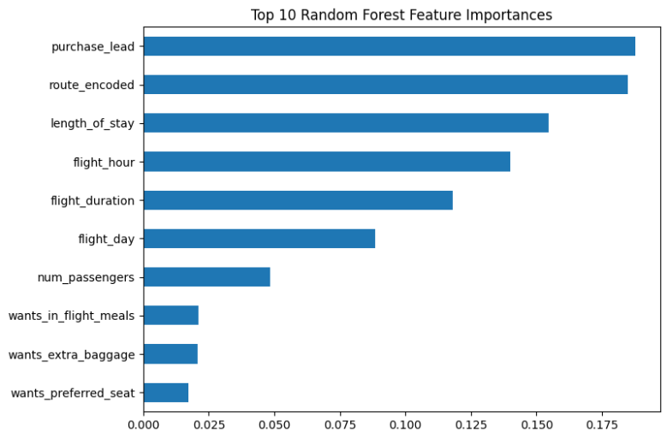
Predictive Model for BRITISH Airline Customer Bookings
Dataset: 49,162 records after outlier capping; balanced subsets (7,362 bookings + 8,000 non-bookings) for training.
Model: RandomForest with CV AUC 0.700 ± 0.011, test AUC-ROC 0.972, accuracy 92%.
Performance: Outstanding discrimination and balance on balanced data.
Top Drivers: Early booking signals and popular routes allow proactive outreach.
Revenue Uplift: Potential 15-20% increase in bookings through personalized promotions.
Operational Benefits: Optimize capacity, reduce waste, and gain competitive advantage in a crowded market.

